Slide 1
CPS 109 - Lab 6

Slide 2
Agenda
Classes
Testing
Actually Writing a Good Program

Slide 3

Agenda
All concepts bring us back to this. You know how we’ve been droning on about using:
Well now we have a use for it!

Slide 4
Classes
What’s a class? I know your profs haven’t gone over this, but if we’re introducing testing, we’ll introduce classes.
A class is simple: it’s a way to consistently define an object.

Slide 5
Classes
Recall: an object is a piece of data in your program. Built in objects are things like ints, lists, etc.
A class is a set of interlinked objects that make up a new object!

Slide 6
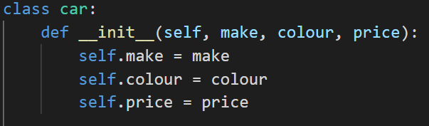
Classes
Let’s make a basic class:
Notice that we use the __init__ here? It’s short for initialize! We use this for when we want to make a new object.

Slide 7

Classes
We can also give it methods! (Just built in functions):

Slide 8
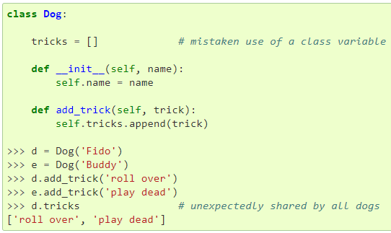
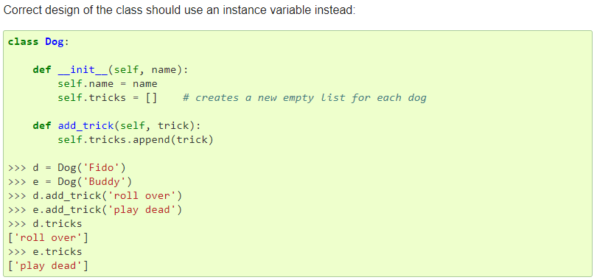
Classes
Be careful about where you put your variables in classes!
Notes:
From the Python documentation on classes: https://docs.python.org/3/tutorial/classes.html

Slide 9
Unit Testing
What is unit testing? Simply put: it’s a way to automate testing your code so you don’t have to run it a million times.

Slide 10
Unit Testing
So why did we introduce classes before showing testing? What does this have to do with that “__main__” business?!

Slide 11
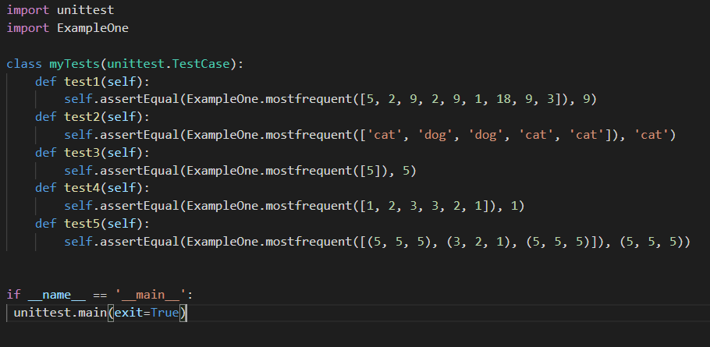
Unit Testing
Let’s look at an example from your prof:

Slide 12
Unit Testing
That’s weird. The most frequent function is in a different file!
That’s because we’re importing it at the top. We can import from different files like we do with libraries. Speaking of libraries, notice how we import “unittest”?

Slide 13
Unit Testing
Long story short: make classes, call methods and classes outside of files you’ve already made, and then test them!

Slide 14
Writing a Program
Why do we bring this up now? You’ve been writing programs since the beginning of the semester.
Correction: you’ve been writing bad programs for the majority of the semester.

Slide 15
Writing a Program
Well that’s not very nice :(

Slide 16
A Word On Locality
A lot of you seem to still struggle with the concept of locality.
Recall: locality is the idea that variables themselves are used and destroyed within specific code blocks. You need to pass data around to local variables in order to maintain that data.

Slide 17
A Word On Locality
Passing around data? Understanding how functions use arguments?? Why can’t I just have variables declared in the ether or use global to declare global variables?

Slide 18
A Word On Locality
The issue with globals and ether variables (as I call them) is simple:
Say you have a large program, consisting of several files. Troubleshooting issues involving variables like that are now a nightmare and next to impossible.

Slide 19
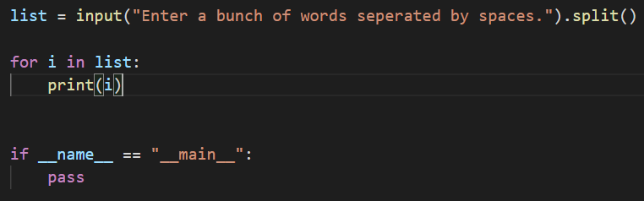
Bad Programming Example

Slide 20
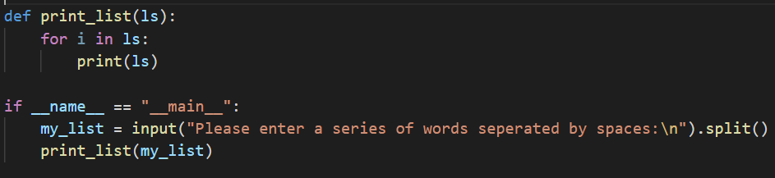
Good Programming Example

Slide 21
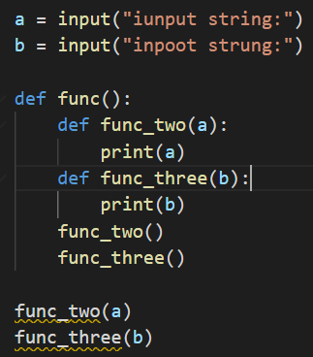
Bad Programming Example

Slide 22
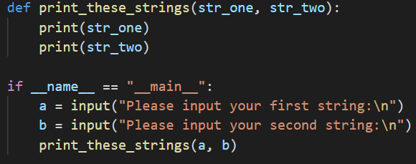
Good Programming Example

Slide 23
Designing A Program
What is expected of me?
What is the functionality I need?
What functions and classes do I need to accomplish this?
Create skeleton for your code.
Write tests
Fill in functions and classes.
Write your main.

Slide 24
Designing A Program
Problem: I need a program that keeps track of baked goods. This should include basic information about the name, ingredients, colours, etc. I need to be able to add and delete baked goods, look up baked goods and update baked goods’ ingredients.

Slide 25
Questions?

